Slide 1
QUANTITATIVE DATA ANALYSIS
& PUBLIC POLICY
Final Course Project
PHD 2023003 Aparna Sharma
DT 2023012 Sarwan kumar

Slide 2
Relationship between UPI & Financial Inclusion in India
Our primary objective was to examine if UPI increases financial inclusion
How do we understand financial inclusion? And what parameters did we employ to examine financial inclusion?
Primary parameters of FI Index include - i) Access ii) Usage iii) Quality (RBI, 2021)
Additionally, there are social, infrastructural and educational components to Financial Inclusion (Yoshino & Morgan, 2016, Singh N, 2017)
We looked at THREE distinct datasets i) Jan Dhan Savings Accounts (monthly data points on number of accounts and account deposits between June 2017-September 2023); then we looked at ii) Micro Credit Activity from rural & semi-urban areas and finally we looked at AePS datasets from 2015-2023

Slide 3
What are our independent and response variables?
CASE I
UPI Volume & Value - Independent Variable
Jan Dhan Savings Accounts (No. of Accounts & Deposit per A/C)- Response Variable
Case II
UPI Volume & Value - Independent Variable
Microcredit Activity (Rural & Semi Urban Credit Accounts & Credit Value Received) - Response Variable
Case III
AePS Volume Data - Independent Variable
Jan Dhan Total Account VOlume - Response Variable

Slide 4
Which statistical models did we use?
CASE I :
We employed a linear regression model and regressed accounts active and deposit per account with UPI value and UPI volume.
UPI value and volume were highly correlated with VIF of of 124 (R² = 99%)
VIF Test for checking the multicollinearity between UPI Value & UPI Value per Transaction.
UPIVolume UPIValuepertransaction
1.052535 1.052535
Replaced UPI value overall with UPI value per transaction to remove multicollinearity. UPI value per transaction was significant for active accounts and not for deposit per account
Case II
We employed a linear regression model and regressed credit accounts and credit received with UPI volume and UPI value per transaction.
UPI value per transaction proved to be insignificant. Only UPI volume proved to be significant

Slide 5
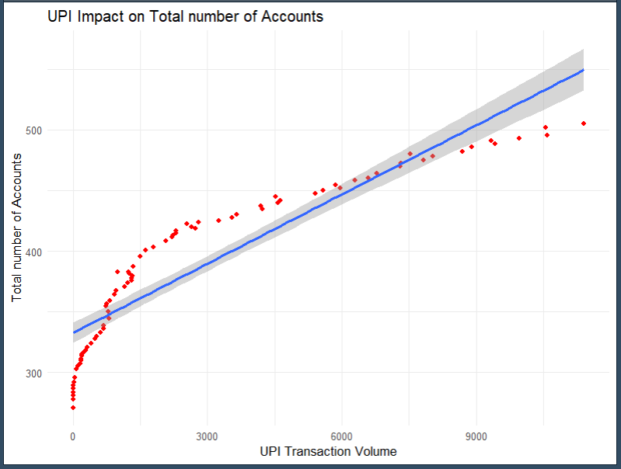
Results for Case 1 - Jan Dhan Active Accounts vs UPI analysis
Total accounts active (y) = 255 (int) + 0.51 * UPI volume + 0.018 * UPI value per transaction (R² = 89%)
Variable | Estimate | Std. Error | t-value | P value
Intercept | 255 | 1.19E+01 | 30.268 | <2e-16
UPI Volume | 5.13E-01 | 9.65E-04 | 19.142 | <2e-16
UPI Value per transaction | 1.80E-02 | 5.84E-03 | 2.425 | 0.0176

Slide 6
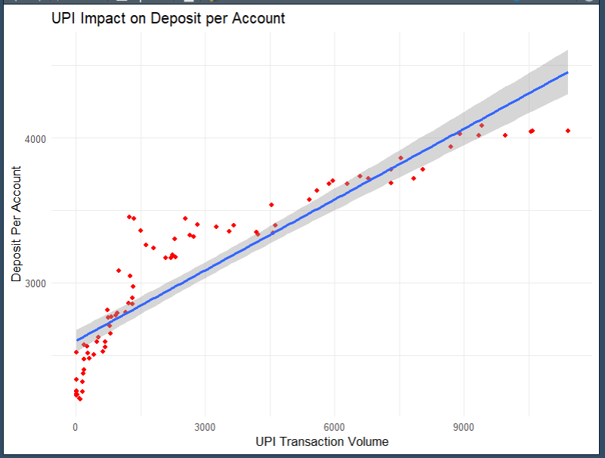
Results for Case 1 - Jan Dhan Active Accounts vs UPI analysis
Deposit per account (y) = 2649 (int) + 0.16 * UPI volume (R² = 82%)
Variable | Estimate | Std. Error | t-value | P value
Intercept | 2649 | 3.42E+00 | 24.14 | < 2e-16 ***
UPI Volume | 1.55E-01 | 8.21E-03 | 18.39 | 1.24e-07 ***

Slide 7
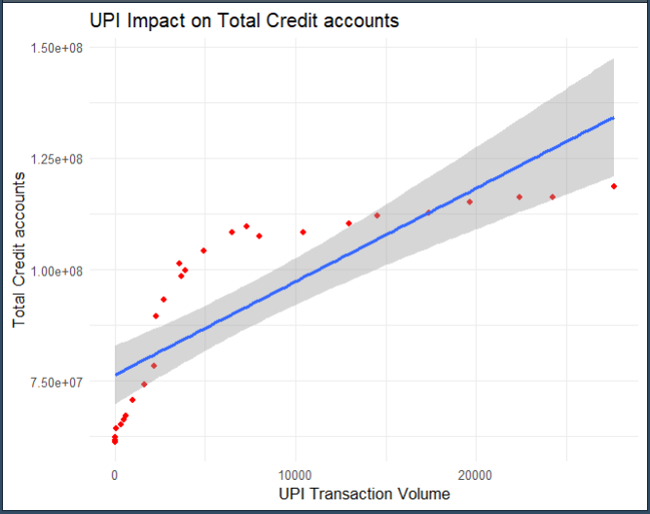
Result for Case 2 - Micro credit activity vs UPI volume analysis
Total accounts active (y) = 76.4 (int) + 0.0021 * UPI volume (R² = 67%)
Variable | Estimate | Std. Error | t-value | P value
Intercept | 76.4 | 2.17E+02 | 25.053 | <2e-16
UPI Volume | 2.10E-03 | 8.08E-03 | 16.11 | 0.012

Slide 8
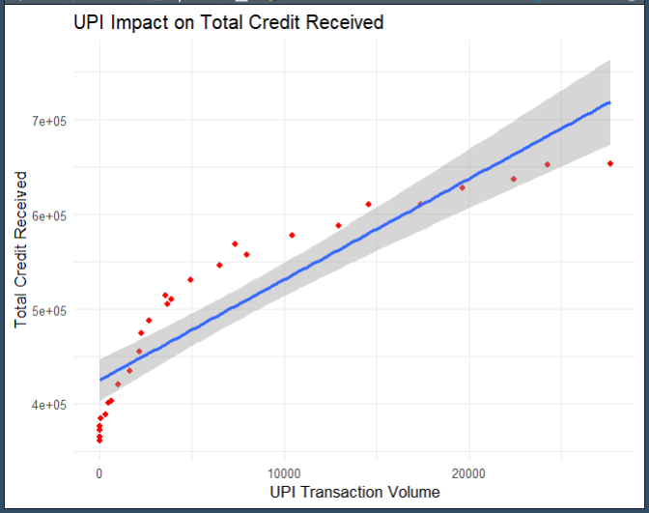
Result for Case 2 - Micro credit activity vs UPI volume analysis
Total Credit received (y) = 425133 (int) + 10.63 * UPI volume (R² = 82%)
Variable | Estimate | Std. Error | t-value | P value
Intercept | 425133.4876 | 26270 | 10.959 | 4.90E-11
UPI Volume | 10.63 | 0.9789 | 6.829 | 3.71E-07

Slide 9
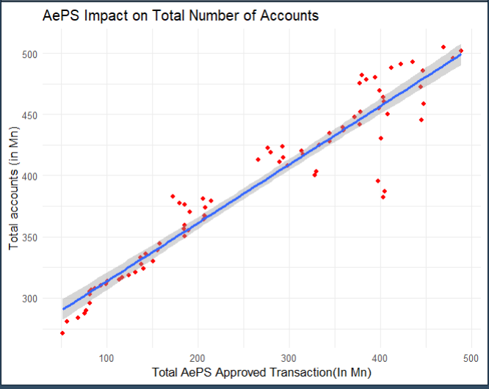
Case 3: Jan Dhan vs AePS transaction volume analysis
We undertook an additional analysis of AePS data with Jan Dhan to examine what relationship exists between the two and how important it is for an offline medium to exist for financial inclusion
Total accounts active (y) = 266 (int) + 0.48 * AePS volume (R² = 91%)
AePS is positively correlated with increased Jan Dhan
activity indicating that offline transactions also have the
power to drive financial inclusion
The coefficient of impact of AePS volume (0.48) is significantly
lower than UPI volume (0.51), indicating that offline transactions
are not driving as much inclusion as online transactions
Variable | Estimate | Std. Error | t-value | P value
(Intercept) | 266 | 4.99073 | 53.32 | <2e-16
Aeps Volume | 0.48 | 0.01692 | 28.17 | <2e-16

Slide 10
Case 3 a) AePS penetration and comparison with UPI
AePS aims to empower people to carry out banking and financial services like fund transfers, cash withdrawals, mini statements, balance inquiries, etc through a business correspondent physically with only the bank name, Aadhar number and biometrics, without needing access to smartphones or OTPs
Month Wise | AePs volume | AePs value | UPI volume | UPI value
Sep-23 | 207.78 | 25542.73 | 10,555.69 | 1579133.18
Aug-23 | 217.43 | 27084.79 | 10,586.02 | 1576536.56
Jul-23 | 229.35 | 29014.2 | 9,964.61 | 1533645.2
Jun-23 | 199.21 | 26038.67 | 9,335.06 | 1475464.27
May-23 | 196.64 | 27489.85 | 9,415.19 | 1489145.5
.... | .... | ....
Apr-18 | 31.06 | 4112.42 | 190.08 | 27,021.85
Mar-18 | 29.39 | 3954.87 | 178.05 | 24,172.60
Feb-18 | 26.48 | 3486.1 | 171.4 | 19,126.20
Jan-18 | 23.92 | 3285.1 | 151.83 | 15,571.20
Aadhar based payments in the last 5 years have increased at a significantly slower pace (8x) than UPI transaction (90x), indicating less popularity and adoption of the offline payment model.

Slide 11
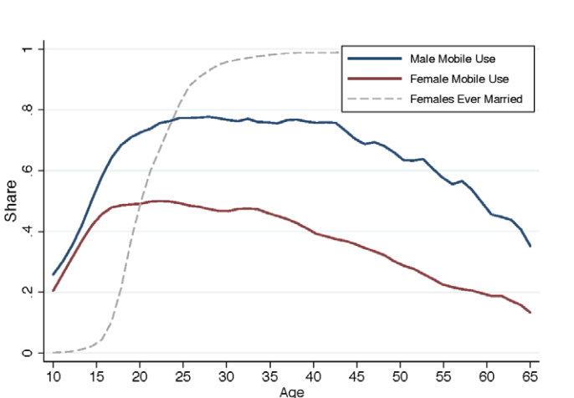
Case 3:An Additional Important Tangent to Look At:
Smartphone penetration amongst the elderly (>50 yrs) is very low both amongst men and women. The elderly cohort have the problem of not just access but also the technological barrier (knowledge and fear) to confidently use smartphones
Increasing penetration of AePS through expansion of micro-ATMs and PoS machines would help increase access to the elderly. Coupling this with bank correspondents present locally to onboard the elderly to banking systems would help drive financial inclusion
Source: https://epod.cid.harvard.edu/sites/default/files/2018-10/A%20Tough%20Call.pdf

Slide 12
Policy Implications & Recommendations
Bank account usage depend significantly on UPI transaction volume and also on transaction per value.
This is intuitive as people care more about the money in their accounts when the value is higher
Any transaction fee either per unit of transaction or % of transaction amount will lower usage and negatively impact financial inclusion
There should be ideally a government directive that there should be no transaction fee levied on UPI transactions
Furthermore, like the state government of Rajasthan, interventions to distribute smartphones amongst women from economically backward backgrounds will be a positive step as smartphone ownership amongst women is lower
However, offline infrastructure such as POS machines are also important so that the people without smartphones aren’t excluded
Micro-credit access also depends on building up a credit score which can only happen with continuous bank activity that UPI has enabled and thus has the capacity to increase access to credit

Slide 13
Limitations of the Study
Educational and Social parameters of Financial Inclusion haven’t been looked at and require a qualitative understanding as well
Internet penetration, quality and access also needs to be taken into account to better understand and drive FI through UPI which has not been undertaken

Slide 14
Sources/References
i) N. Yoshino. and Morgan, P. 2016. Overview of Financial Inclusion, Regulation, and Education. ADBI Working Paper 591. Tokyo: Asian Development Bank Institute. Available: http://www.adb.org/publications/overview-financial-inclusion-regulation-and-education/
ii) N. Singh. 2017. Financial Inclusion: Concepts, Issues and Policies for India. Department of Economics University of California, Santa Cruz. Available: https://economics.ucsc.edu/research/downloads/singh_financial_inclusion.pdf
iii) Reserve Bank of India. Financial Inclusion Index. 2021 https://rbi.org.in/Scripts/BS_PressReleaseDisplay.aspx?prid=51382
iv) Ravi, S. (2019). Accelerating financial inclusion - brookings. https://www.brookings.edu/. https://www.brookings.edu/wp-content/uploads/2019/03/Accelerating-Fin-Inclusion-2019-updated-8x10-v2.0.pdf
v) Dataset Source: https://www.npci.org.in & https://pmjdy.gov.in/BankwiseLatest

